Slide 1

Predicting Severe Traffic Accidents Using Machine Learning and Time Series Analysis
Final Project Presentation
Team Members: Funbi Abolarin, Poorna Haneesha Kanneganti, Triveni Surabattuni, Kavya Bandi

Slide 2
Project Overviw
Problem Statement:
Road accidents are a leading cause of injuries and fatalities in urban areas
Need for data-driven approaches to anticipate and prevent severe crashes
Motivation:
Rising concern for public safety and traffic management
NYC offers rich historical crash data for analysis
Project Goals:
Identify patterns contributing to severe crashes
Develop ML models for real-time prediction
Use time series to detect seasonal crash trends
Impact:
Assist policymakers and urban planners
Enable proactive resource allocation (e.g., emergency services)
Improve traffic safety and awareness

Slide 3
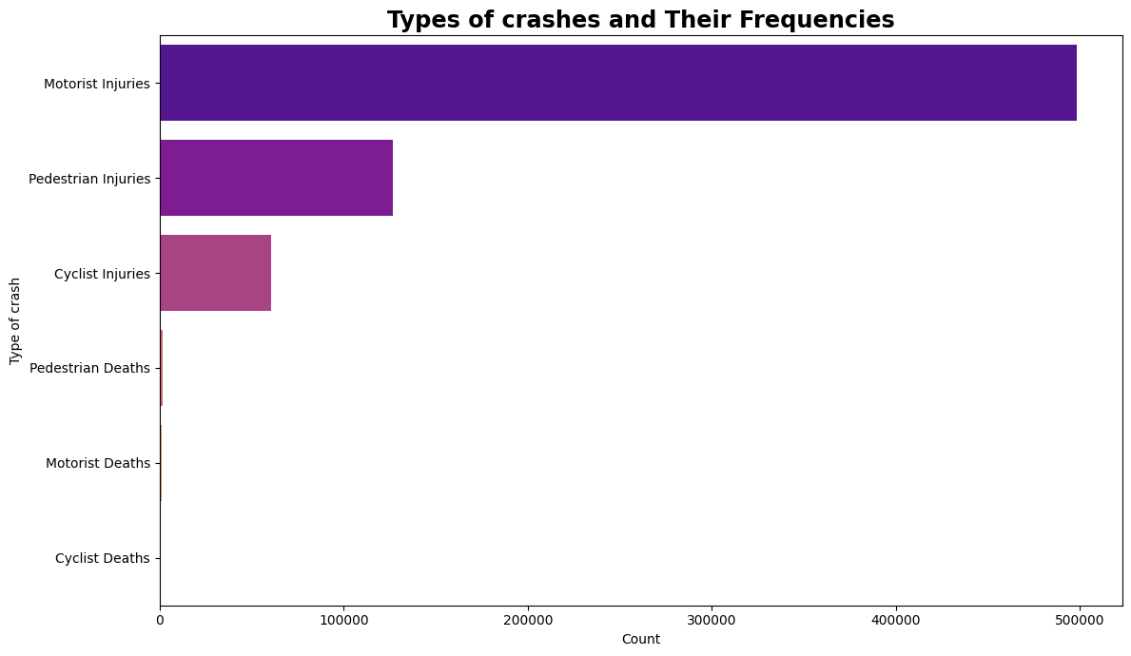
Data Cleaning Process:
Removed columns with more than 18% missing values
Retained latitude and longitude for future spatial analysis
Dropped sparsely populated text-heavy columns
Feature Engineering:
From CRASH DATE and CRASH TIME, derived:
DAY_OF_WEEK, MONTH, YEAR, IS_WEEKEND
HOUR, TIME_PERIOD (e.g., morning, afternoon), SEASON
Added meaningful binary target labels:
SERIOUS_CRASH → (≥1 fatality or multiple injuries)
PEDESTRIAN_INVOLVED, CYCLIST_INVOLVED, FATAL_CRASH
Crash Type Aggregation:
Plotted crash outcomes using bar plots and boxplots
Revealed motorists as the most affected group

Slide 4
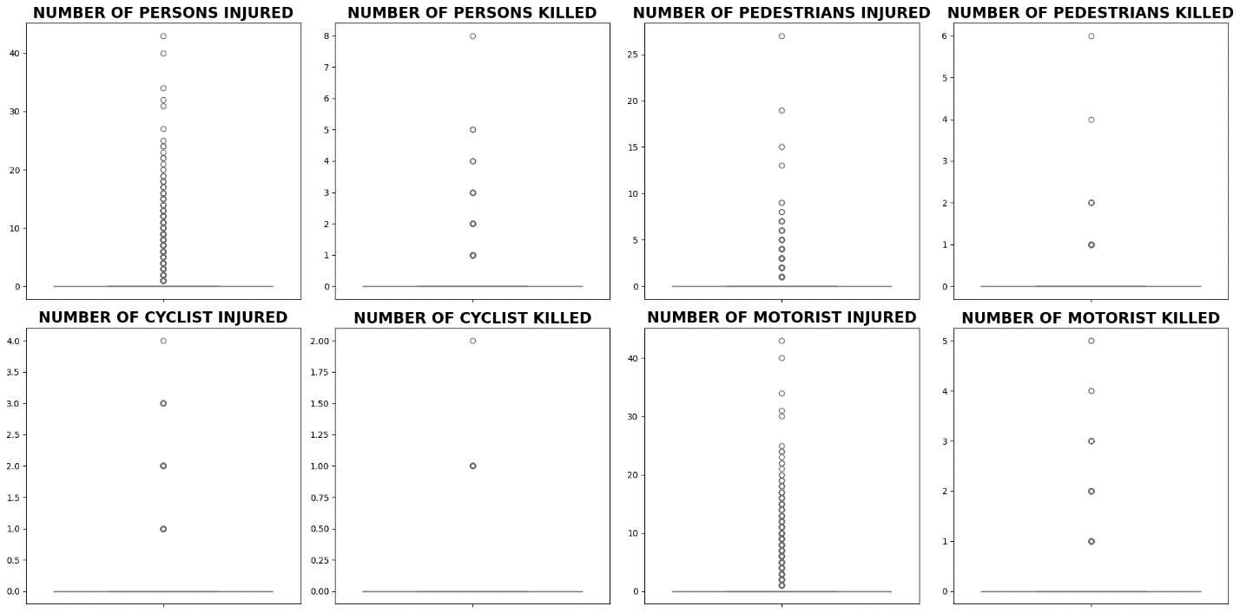
Injury & Fatality Types Captured:
Each subplot shows the count distribution for:
Persons Injured / Killed
Pedestrians Injured / Killed
Cyclists Injured / Killed
Motorists Injured / Killed
🔍 Key Observations:
Injury counts dominate over fatalities in every category
Motorists have the highest frequency of injury incidents
Cyclist and pedestrian fatalities are less frequent but non-negligible
📊 Plot Interpretation:
Each circle represents one crash event
The vertical alignment indicates repeated counts (e.g., many events with 1 person injured)
The majority of values are clustered at zero, confirming that most crashes are non-fatal and involve minor injuries
📈 Insights for Modeling:
Supports the use of binary classification for SERIOUS_CRASH target
Class imbalance (few fatal events) justifies stratified sampling and future use of SMOTE

Slide 5
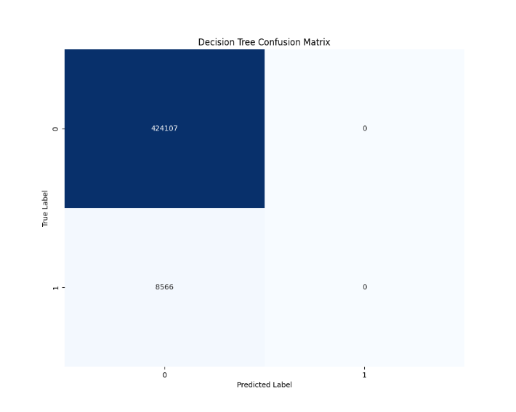
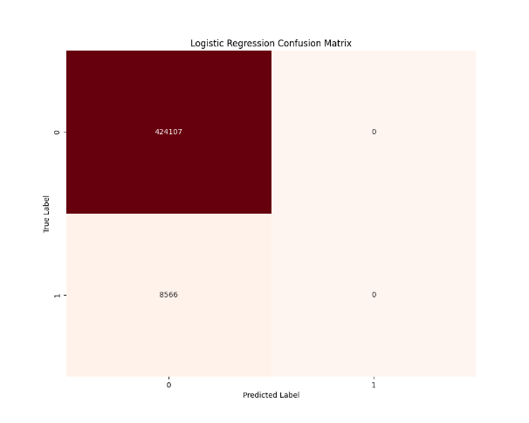
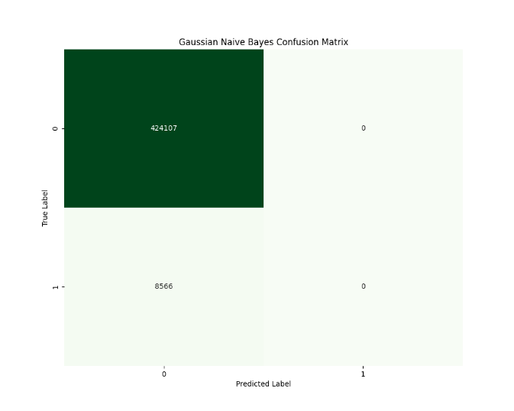
we evaluated three different classification algorithms—Logistic Regression, Decision Tree, and Gaussian Naive Bayes—to predict the likelihood of a serious traffic crash. Each model was assessed using 5-fold stratified cross-validation and evaluated based on accuracy, weighted F1 score, and ROC-AUC. Among the models, Logistic Regression outperformed the others with an accuracy of 77.5%, an F1 score of 76.7%, and an ROC-AUC of 0.837, indicating a relatively strong ability to distinguish between serious and non-serious crash outcomes.
However, when we examined the confusion matrices, it became evident that all models failed to correctly identify the minority class—serious crashes. The models overwhelmingly predicted the majority class (non-serious crashes), resulting in high true negatives but zero true positives. This reflects a common problem in real-world datasets with severe class imbalance, where rare but critical events are overshadowed during model training. As seen in the confusion matrix visuals, the models were biased towards predicting all outcomes as non-serious. This highlights the need for improved class balancing techniques such as SMOTE or ADASYN, which can synthetically generate minority class examples to help models learn their patterns more effectively.

Slide 6
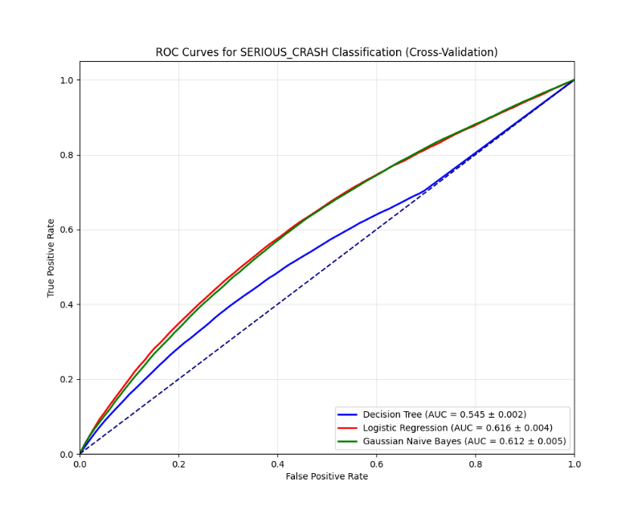
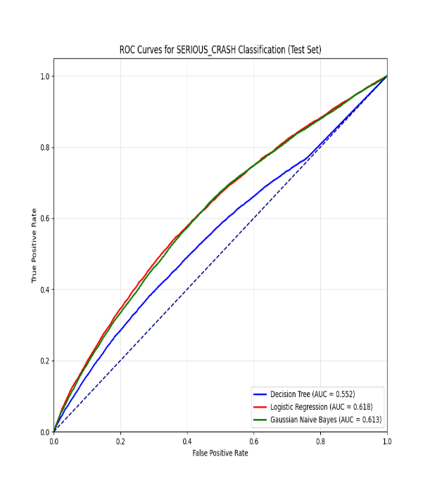
Logistic Regression
we’ve visualized the ROC curves for all three classification models—Logistic Regression, Gaussian Naive Bayes, and Decision Tree—on both the cross-validation folds and the final test set. Logistic Regression emerged as the top performer across all metrics.
Let’s start with the top graph. This shows the ROC curves from 5-fold cross-validation. As you can see, the Logistic Regression model—highlighted in blue—consistently performs the best, with an AUC of about 0.616. Gaussian Naive Bayes is close behind with an AUC of 0.612. The Decision Tree model, shown in red, clearly underperforms here with an AUC of just 0.545, indicating weaker class separation.
Now, moving to the downside—this is our ROC curve on the actual test set. Again, Logistic Regression and Naive Bayes perform similarly, with AUCs around 0.618 and 0.613 respectively. Decision Tree improves slightly on the test set but still lags at 0.552.
What’s important to note here is that while all models perform better than random guessing—which would be a diagonal line with an AUC of 0.5—they still struggle to effectively identify serious crashes. This reflects the class imbalance issue that we also observed in the confusion matrices, where all models failed to correctly predict the minority class.
These visualizations confirm that Logistic Regression is the most reliable classifier among the three, but they also highlight the need for improving our pipeline—possibly by applying class balancing techniques like SMOTE or by exploring alternative models.

Slide 7
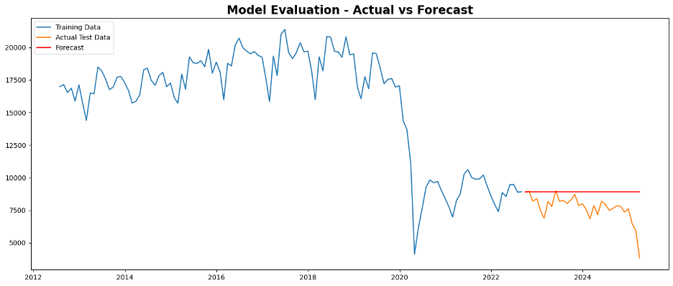
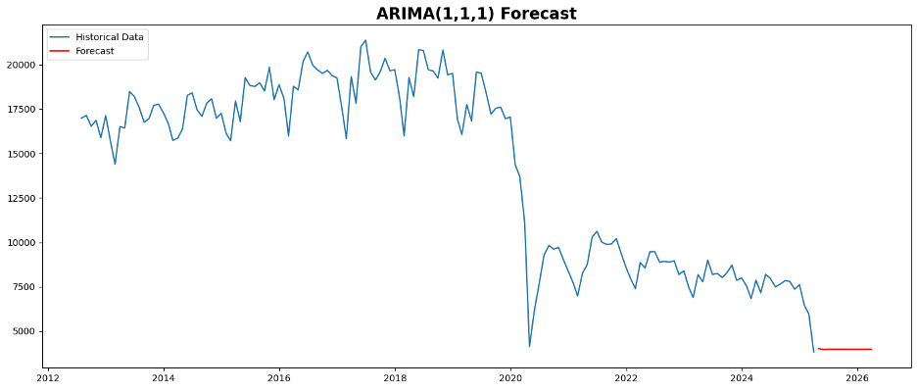
ARIMA Time Series Model
In this slide, we present the results of time series forecasting using the ARIMA(1,1,1) model applied to monthly crash totals from 2012 to 2025. The first graph shows the complete historical data alongside the 12-month future forecast in red. One of the most noticeable trends is the steep decline in crash counts beginning around 2020, which aligns with the impact of the COVID-19 pandemic and related mobility restrictions. Post-2020, the trend remains lower and somewhat unstable, with our model projecting a continued gradual decrease in crash totals.
The second graph compares the model's forecast against actual test data. The training data is shown in blue, actual test data in orange, and the red line represents the predicted values. While the model captures the downward trend, it fails to reflect the seasonal dips and spikes present in the actual test data. This mismatch points to a limitation of the ARIMA model in handling complex variability and noise in real-world crash data.
Model performance was evaluated using multiple statistical criteria. The AIC, BIC, and HQIC values (1712.24, 1720.87, and 1715.56 respectively) suggest a decent fit, but residual diagnostics show mixed results. The Ljung-Box test returned a p-value of 0.51, indicating no significant autocorrelation in residuals—this is good. However, the Jarque-Bera test indicated non-normality, and the residuals displayed heteroskedasticity, meaning the variance of errors isn’t constant over time. These are signs that the model could be improved.
In terms of error metrics, the Mean Squared Error was over 2.4 million, with an RMSE of 1567.03 and MAE of 1230.08. While these numbers are acceptable given the size of the dataset, there’s definitely room for improvement, possibly by using more advanced models like SARIMA or Prophet in future iterations.

Slide 8
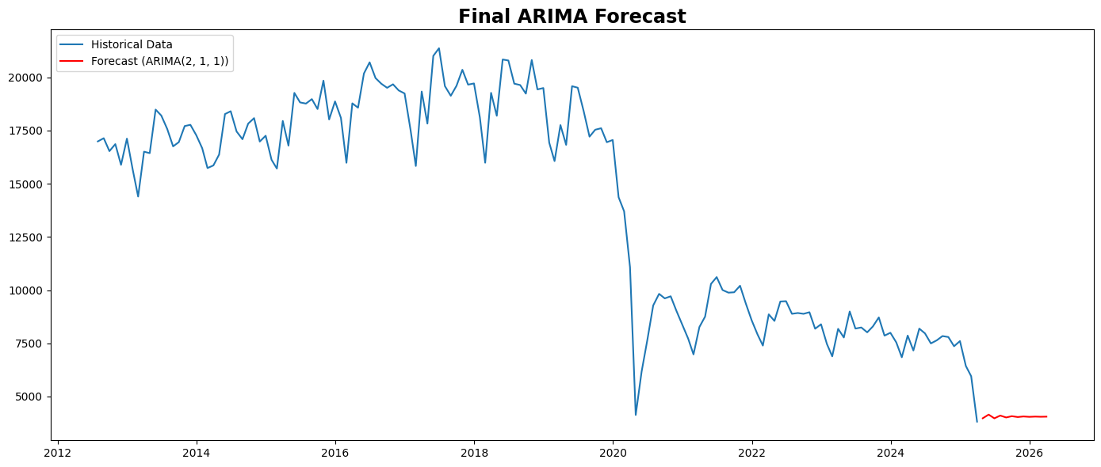
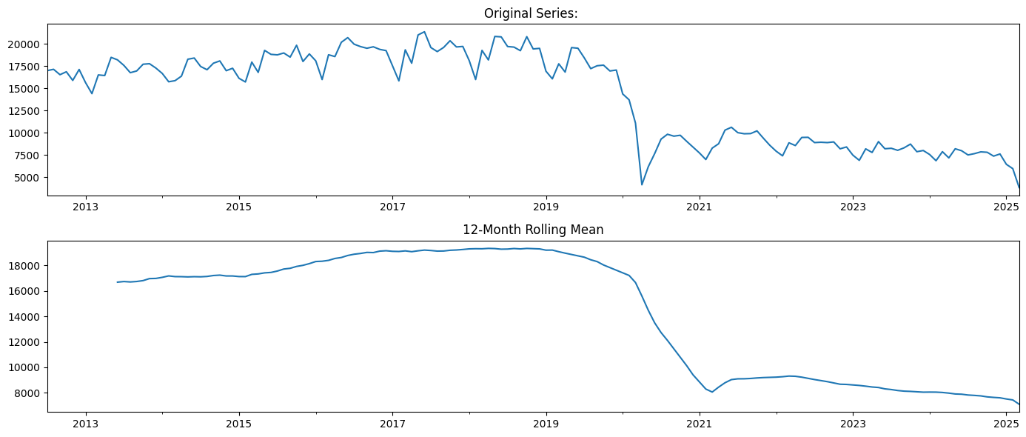
Conclusion
Successfully applied ML & time series forecasting to NYC crash data
Logistic Regression gave the best classification results
All models struggled with serious crash detection due to class imbalance
ARIMA model captured long-term crash trends well
Some forecasting limitations: error variance & non-normality
Future scope: use SMOTE, SARIMA/Prophet, and add weather/spatial data

